Slide 1
CIS CONTROL 14: CONTROLLED ACCESS-NEED TO KNOW-II
CONTROLLED ACCESS BASED ON THE NEED TO KNOW

Slide 2
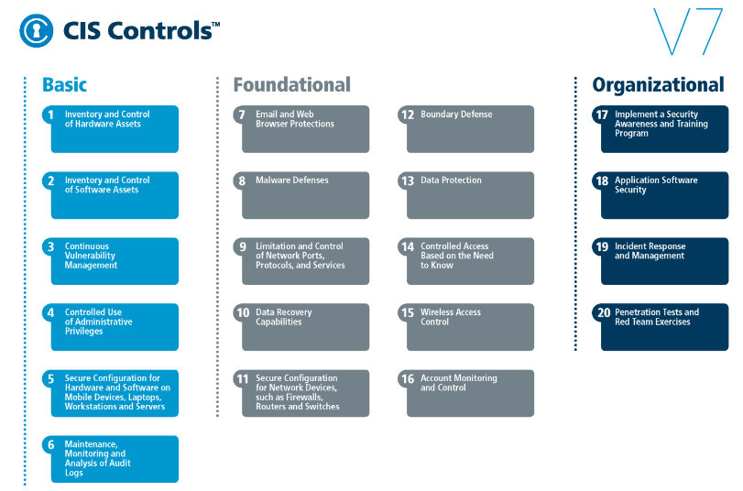
CIS CONTROL 14: CONTROLLED ACCESS-NEED TO KNOW-II
https://www.cisecurity.org/controls/

Slide 3
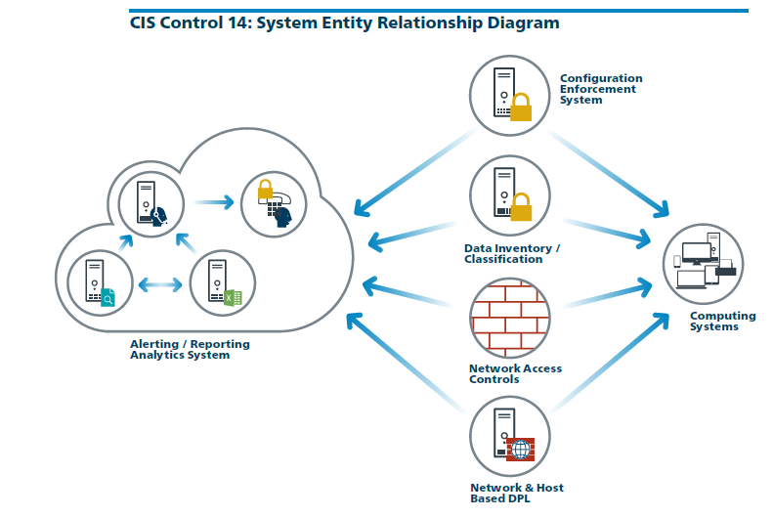
CIS CONTROL 14: CONTROLLED ACCESS-NEED TO KNOW-II
https://www.cisecurity.org/controls/

Slide 4
CIS CONTROL 14: CONTROLLED ACCESS-NEED TO KNOW-II
14.6: Protect Information through Access Control Lists
Protect all information stored on systems with file system, network share, claims, application, or database specific access control lists. These controls will…

Slide 5
CIS CONTROL 14: CONTROLLED ACCESS-NEED TO KNOW-II
14.6: Protect Information through Access Control Lists
…enforce the principle that only authorized individuals should have access to the information based on their need to access the information as a part of their responsibilities.

Slide 6
CIS CONTROL 14: CONTROLLED ACCESS-NEED TO KNOW-II
14.7: Enforce Access Control to Data through Automated Tools
Use an automated tool, such as host-based Data Loss Prevention, to enforce access controls to data even when data is copied off a system.

Slide 7
CIS CONTROL 14: CONTROLLED ACCESS-NEED TO KNOW-II
14.8: Encrypt Sensitive Information at Rest
Encrypt all sensitive information at rest using a tool that requires a secondary authentication mechanism not integrated into the operating system, in order to access the information.

Slide 8
CIS CONTROL 14: CONTROLLED ACCESS-NEED TO KNOW-II
14.9: Enforce Detail Logging for Access or Changes to Sensitive Data
Enforce detailed audit logging for access to sensitive data or changes to sensitive data (utilizing tools such as File Integrity Monitoring or Security Information and Event Monitoring).
END

